Slide 1
Project 1-Pokemon
Pham Hai Nguyen (Shayne)

Slide 2
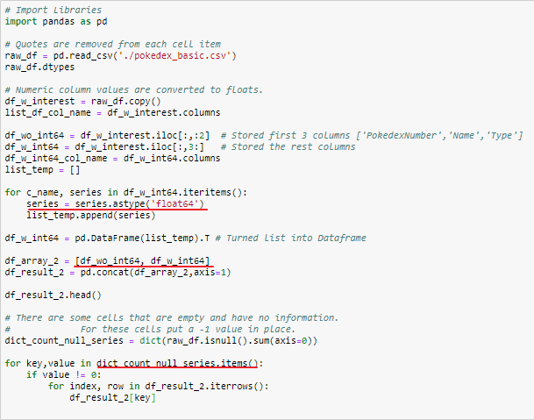
My Archivement
Understand about data structures
Dictionary in dictionary
List in list
Usage of function and its return.
Find out how useful of Pandas

Slide 3
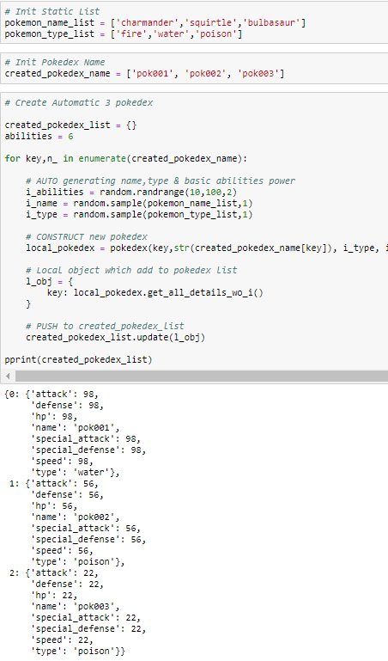
My Archivement
Some Inputs by using random
built-in method.

Slide 4
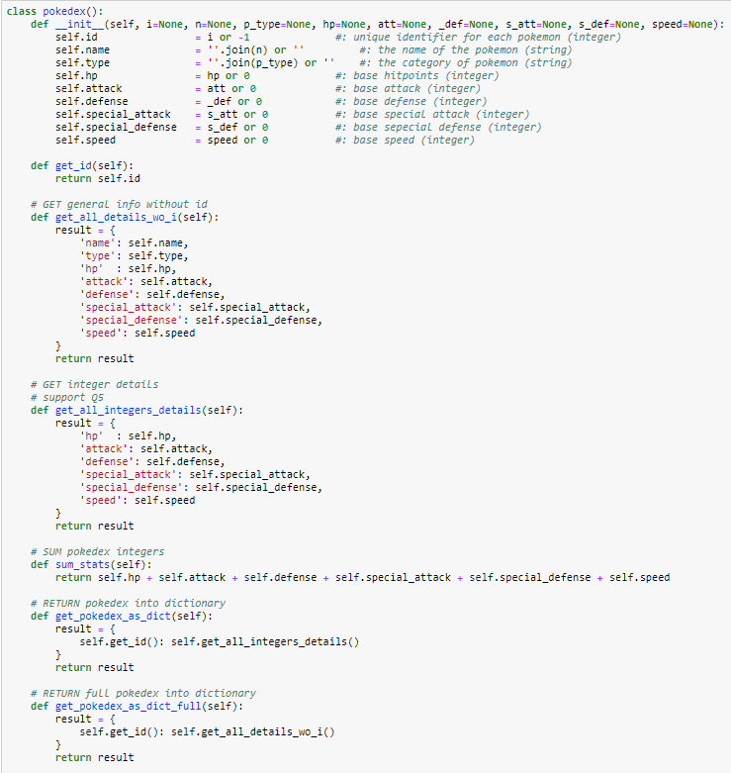
My Archivement
Built player, pokedex,
player_dictionary class

Slide 5
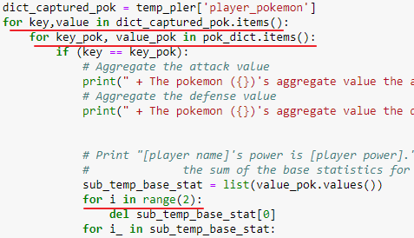
My failure
Code is not organized
Low for maintenance
Usage of Loop inside another loop

Slide 6
Q&A

